Slide 1
Computer Organization 2025 Assignment I
Due Date: 23:59, April 10, 2025

Slide 2
Overview
The assignment includes three exercises.
You will write inline assembly code and run it on the RISC-V Spike simulator to get results.
The goal is to practice low-level programming and understand how assembly interacts with C.

Slide 3
Prerequisite: HW0 - Set up your environment
Follow the procedures listed in the HW0 document to set up the environment.
Install the following tools:
GNU toolchain for RISC-V used to compile C code for RISC-V.
RISC-V ISA simulator (Spike) which emulates a RISC-V system.
Proxy kernel which handles system call redirection.

Slide 4
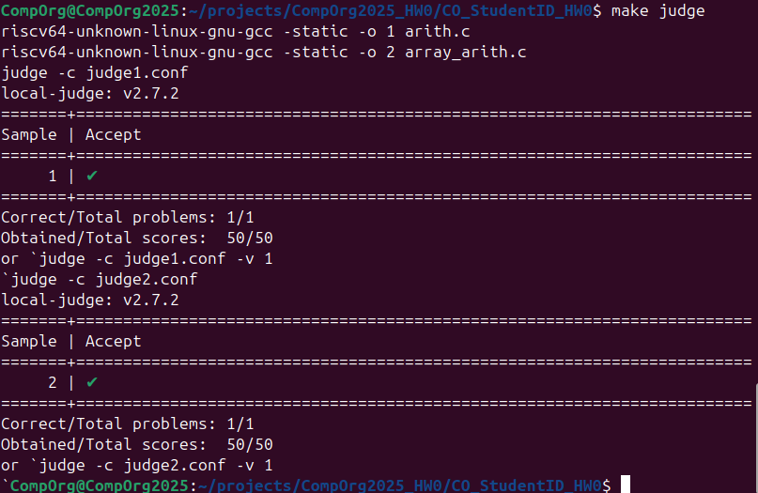
Prerequisite: HW0 - Test your environment
You can use the command `make judge` to verify that the environment is set up correctly.

Slide 5
Assignment - 3 Coding Exercises
In this assignment, you will complete three exercises by implementing inline assembly in a C program.
Exercise 1 (Array Bubble Sort, 20%)
Exercise 2 (Array Search, 40%)
Exercise 3 (Linked-List Merge Sort, 40%)

Slide 6
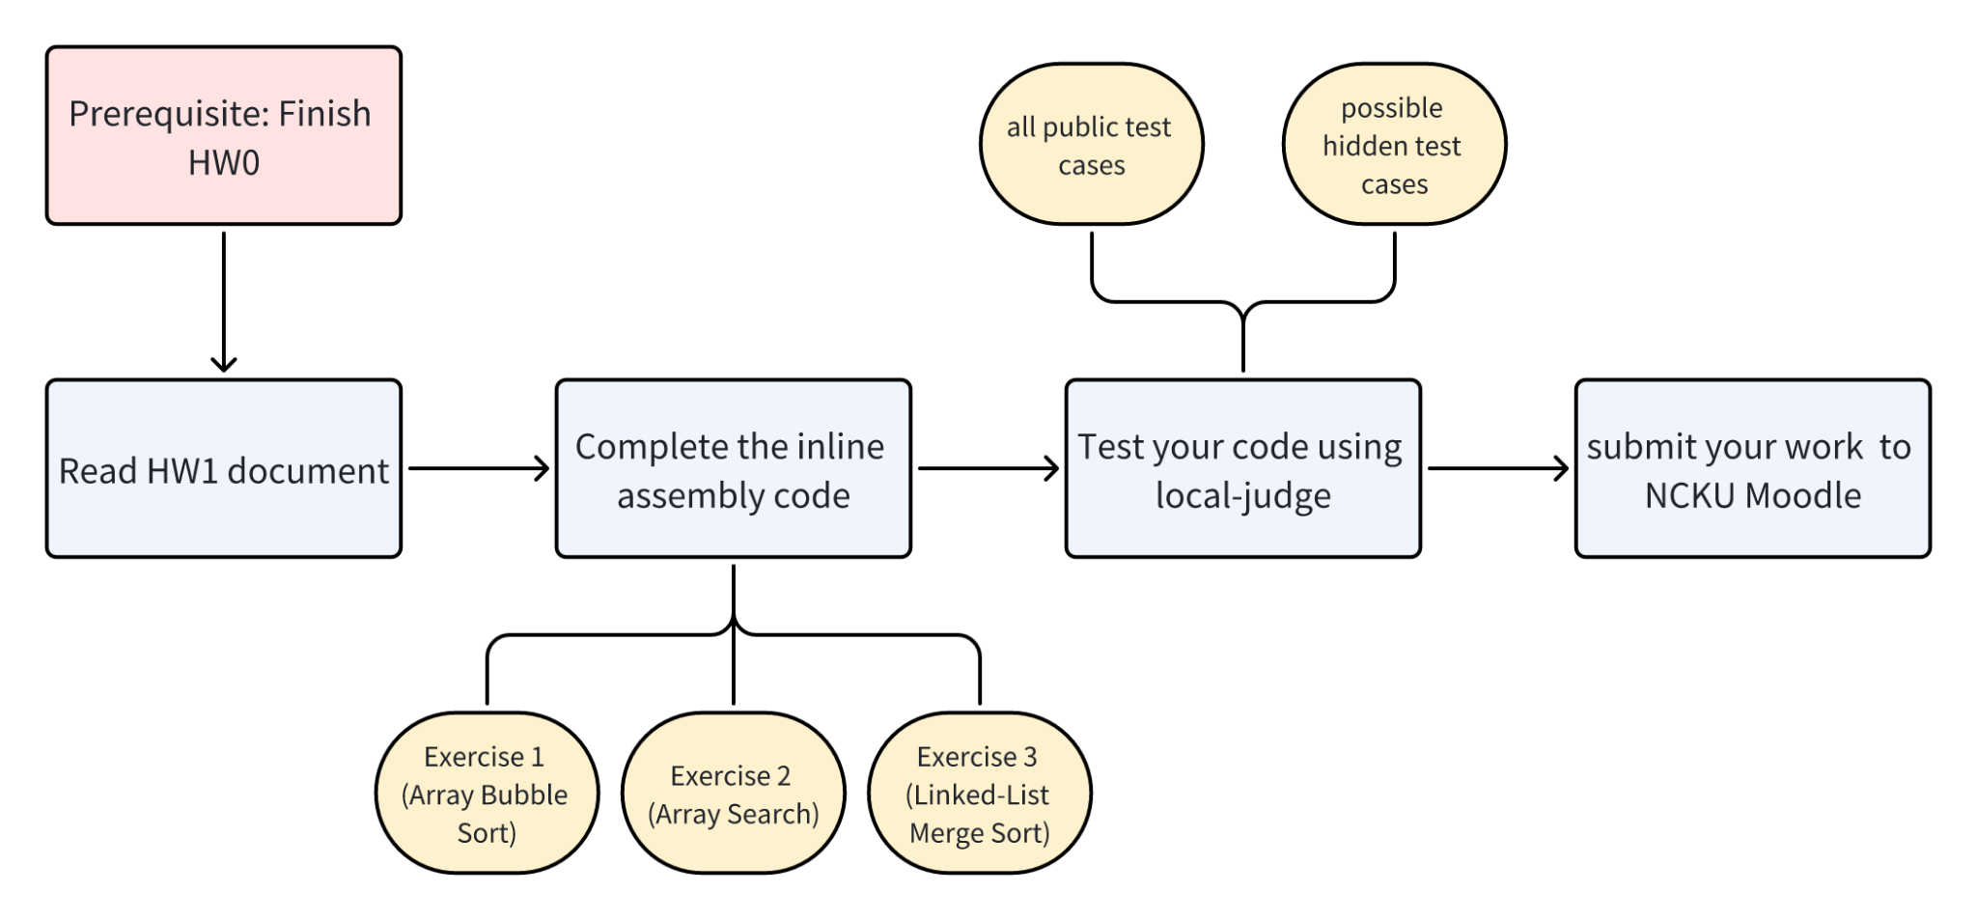
Suggested Workflow

Slide 7


Exercise 1 (Array Bubble Sort, 20%)
Input: The first line is the array size, followed by the array elements matching the given size.
Output: A single line with the sorted array.

Slide 8


Exercise 2 (Array Search, 40%)
Input: The first line is the array size, the second line contains the array elements, and the third line is the target value to search.
Output: A single integer representing the target's index, or -1 if not found.

Slide 9
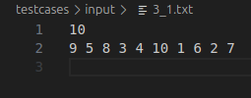

Exercise 3 (Linked-List Merge Sort, 40%)
Input: The first line is the number of linked list elements, followed by the elements matching this count.
Output: A single line with the sorted linked list.

Slide 10
Test Your Assignment
Please install local-judge according to the HW0 instructions to test your program.
You have two ways to run tests:
Use `make judge` to test all exercises.
Use `judge -c judge.conf` to test a specific exercise.

Slide 11
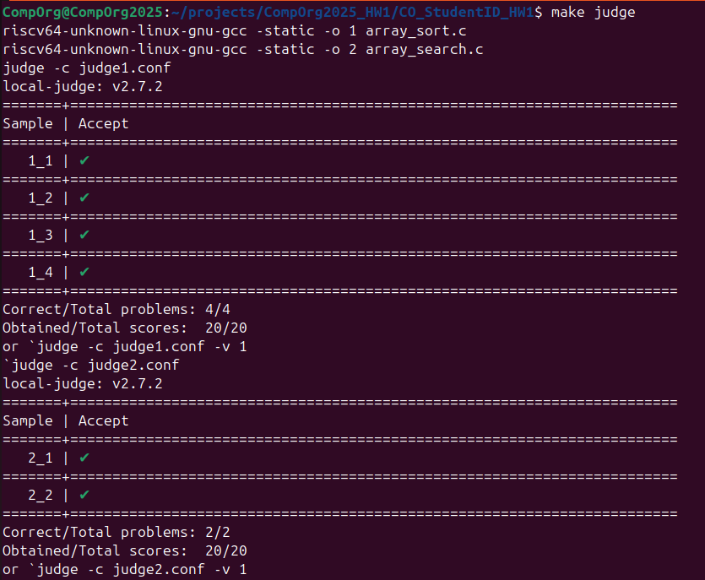
`make judge`
Test all exercises and all public test cases.

Slide 12
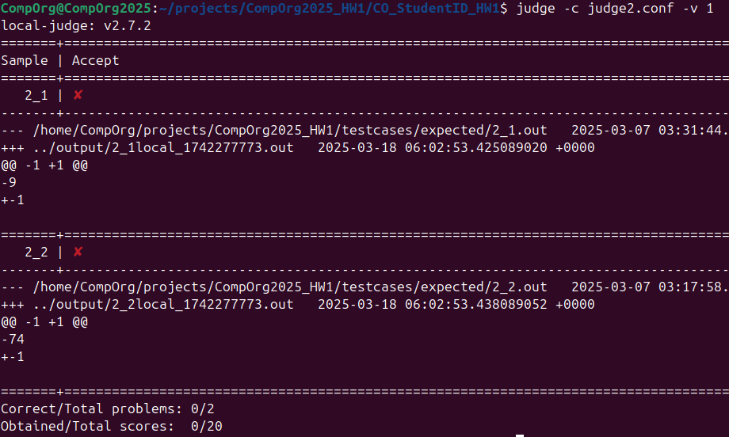
`judge –c judge.conf –v 1`
Test a specific exercise.
Add `-v 1` to the command if you need more information.

Slide 13
Submission of Your Assignment
Compress your source files into a zip file.
Submit your assignment to NCKU Moodle.
NOTE: Change all CO_StudentID to your student ID number, e.g., F12345678.zip.

Slide 14
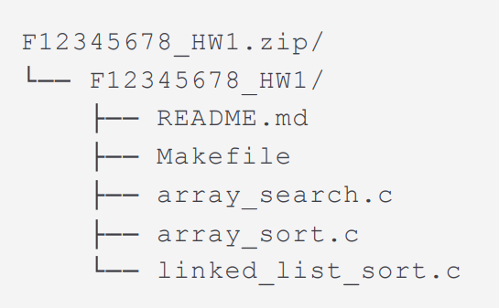
Example file organization of zip file
The example zip file for the student with the student ID, F12345678.

Slide 15
Scoring Criteria
Total: 100 points
Exercise 1: 4 public test cases (5 pts each) → 20 pts
Exercise 2: 2 public + 2 hidden test cases (10 pts each) → 40 pts
Exercise 3: 2 public + 2 hidden test cases (10 pts each) → 40 pts

Slide 16
Scoring Criteria - About README.md
README.md is mandatory.
Although it does not contribute to your score, failing to submit README.md will result in a score of zero for this assignment.

Slide 17
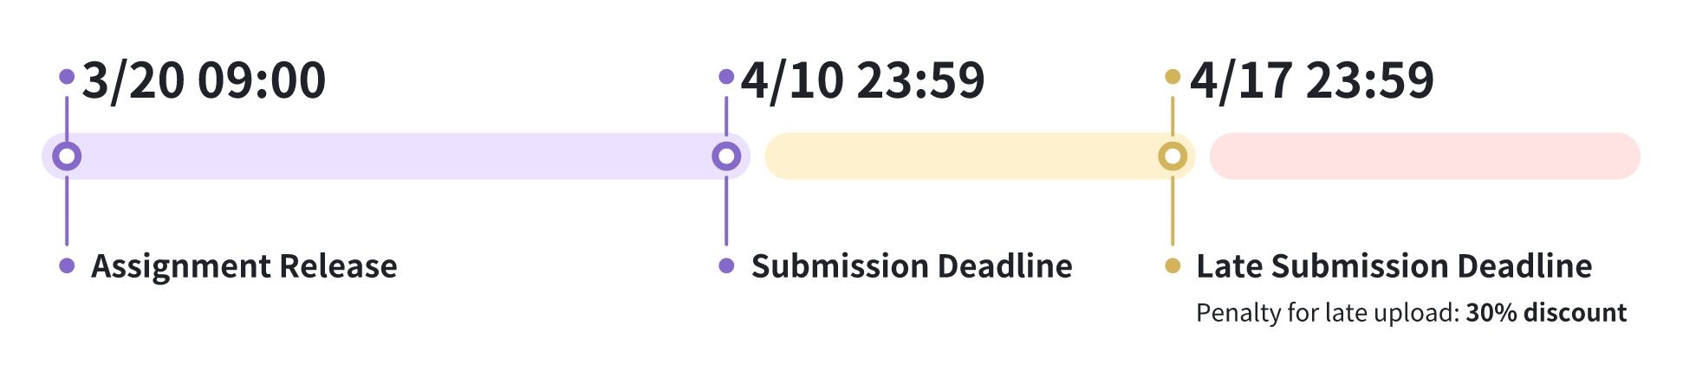
Important Note
Penalty for late upload
30% discount
within seven days of the given deadline
Incorrect format will lose 10 points.
A high similarity score between your code and someone else's will result in a score of zero for this assignment.

